Slide 1
Visual and tactile based shared control for remote palpation
Jingwen Zhao
Supervisor: Fumiya Iida, Leone Costi
Bio-Inspired Robotics Laboratory

Slide 2
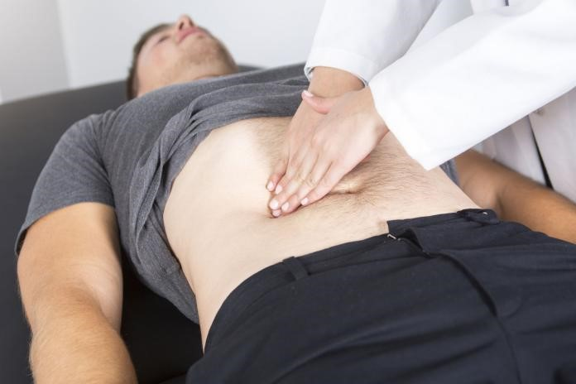
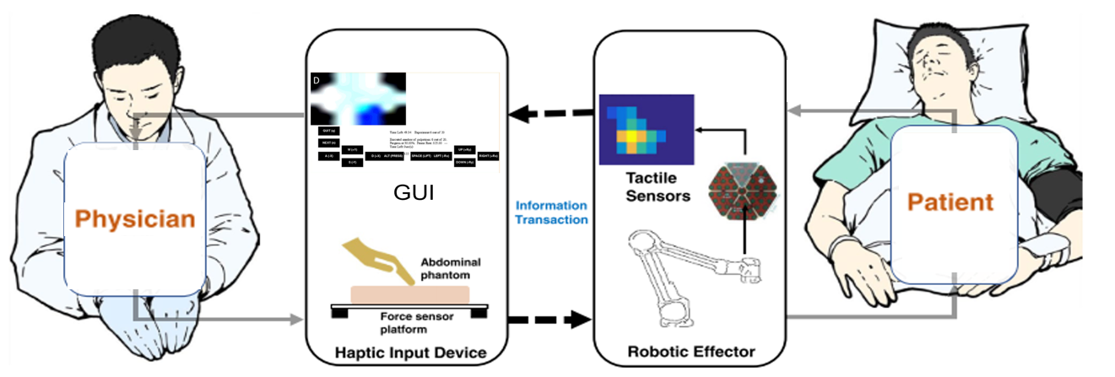
Palpation & remote palpation
Notes:
Palpation is the process of using one's hands to check the body of patient during a physical examination. As simple as the action may seem, it can provide information all the way from just beneath the skin to organs deep inside the body. An experienced examiner is able to, for example tell from the tenderness of muscle to know whether there might be any damage or infection, or even guess a potential spot of cancer from the inconsistency of the organ texture.
What I’m trying to study here, is the potential of remote palpation. We’ve had remote etc, or even davinci for remote surgical operation. So what about remote palpation? As simple as it may sounds, it’s a very complicated process to model as there’s so many complicated interaction between the pose of the hand or the position of the patient etc. The doctor then reads all these intricate information from the subtle difference on their fingertip.
We can start with a simple paradigm of remote palpation. ..

Slide 3
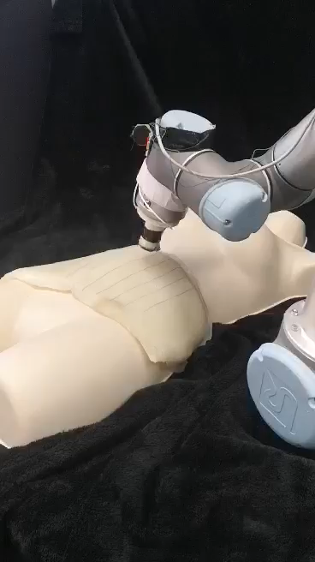
Shared control
Problem:
Capable of dextrous task but difficult to control
Solution: Shared Control
Let the robot perform what the doctor WANT to perform
Handle rotational movement automatically
Target:
Enable user to perform complex palpation task with faster speed, higher accuracy and make better decisions
Notes:
HOWEVER, not much application is seen in the healthcare and will be the key to unlock the full potential of our remote palpation system
Hazardous waste handling, autonomous driving, prosthetic limb
Widely used in fields such as hazardous waste handling, autonomous driving, prosthetic limb

Slide 4
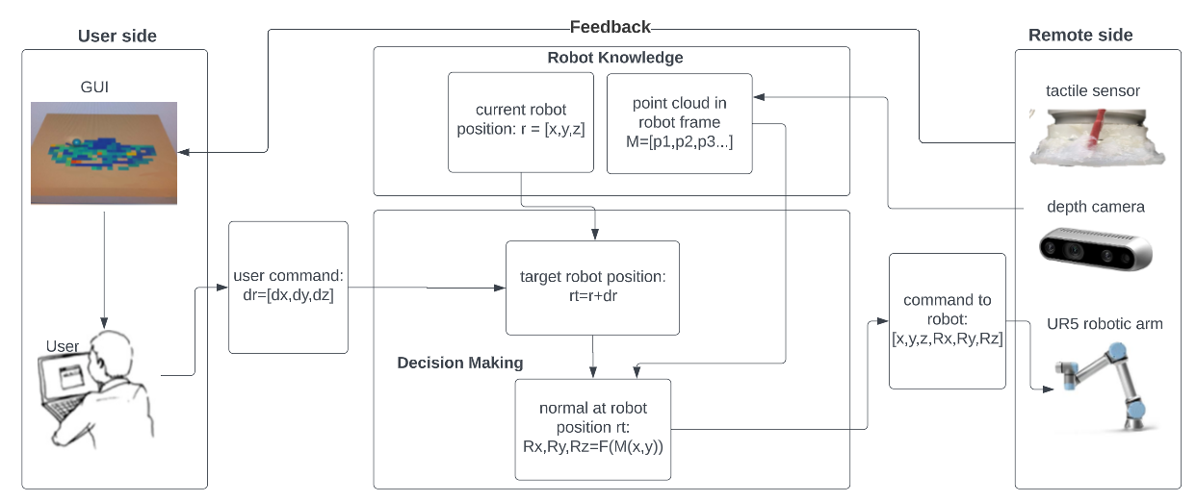
Shared control system paradigm

Slide 5
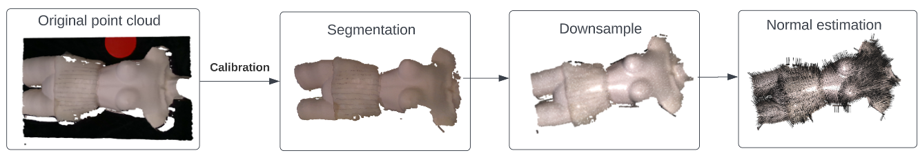
Surface reconstruction
Reconstruction with abdominal phantom on mannequin

Slide 6
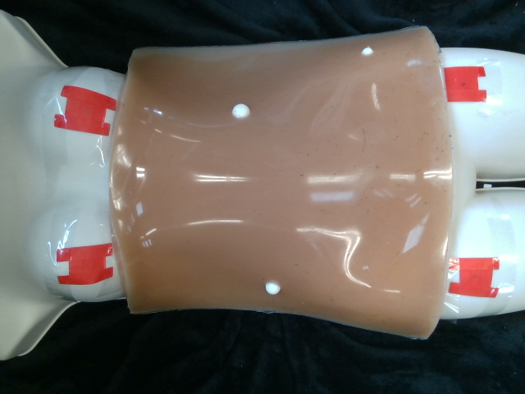

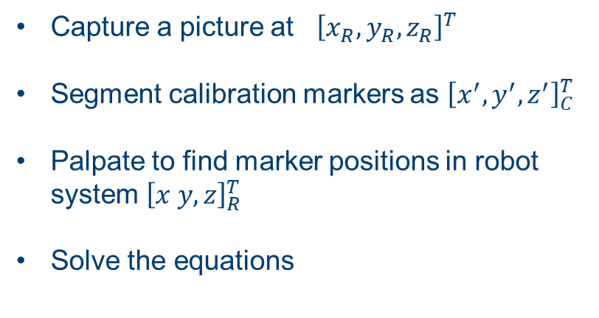
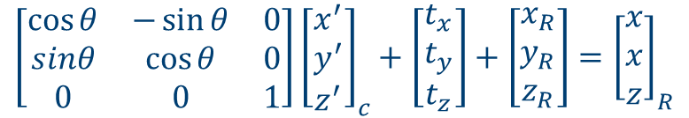

Calibration
The reconstructed point cloud needs to be converted from the camera system to the robot system
Capture a picture at ${\left[x_{R}, y_{R}, z_{R}\right]}^{T}$
Segment calibration markers as ${\left[x^{′}, y^{′}, z^{′}\right]}_{C}^{T}$
Palpate to find marker positions in robot system ${\left[x y, z\right]}_{R}^{T}$
Solve the equations
$$θ, t_{x}, t_{y}, t_{z}$$
$$\left[x^{′}, y^{′},z^{′}\right]−−−−−→[x, y, z]$$
$$\left[\begin{matrix}\cos{θ} & −\sin{θ} & 0 \\ sinθ & \cos{θ} & 0 \\ 0 & 0 & 1\end{matrix}\right]{\left[\begin{matrix}x^{′} \\ y^{′} \\ z^{′}\end{matrix}\right]}_{c}+\left[\begin{matrix}t_{x} \\ t_{y} \\ t_{z}\end{matrix}\right]+\left[\begin{matrix}x_{R} \\ y_{R} \\ z_{R}\end{matrix}\right]={\left[\begin{matrix}x \\ x \\ z\end{matrix}\right]}_{R}$$

Slide 7
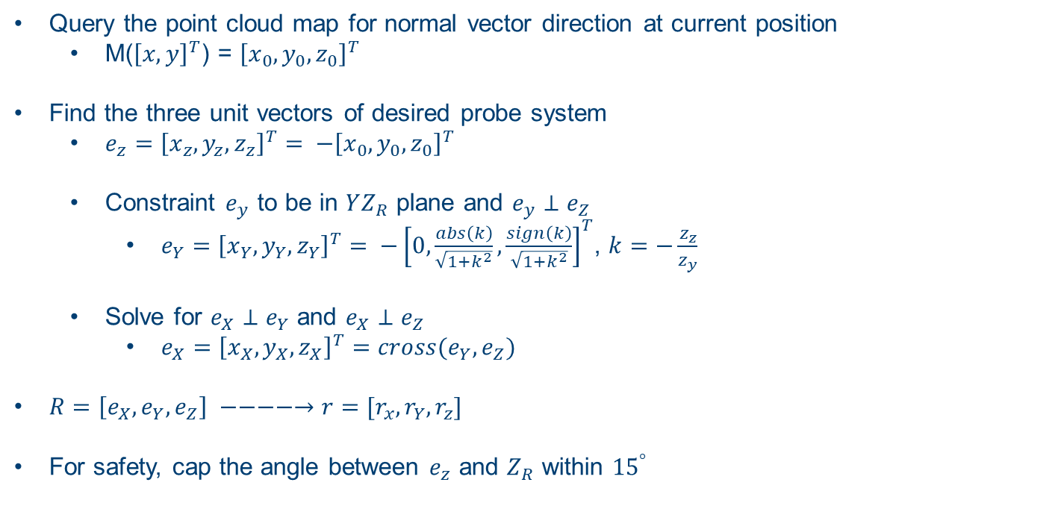
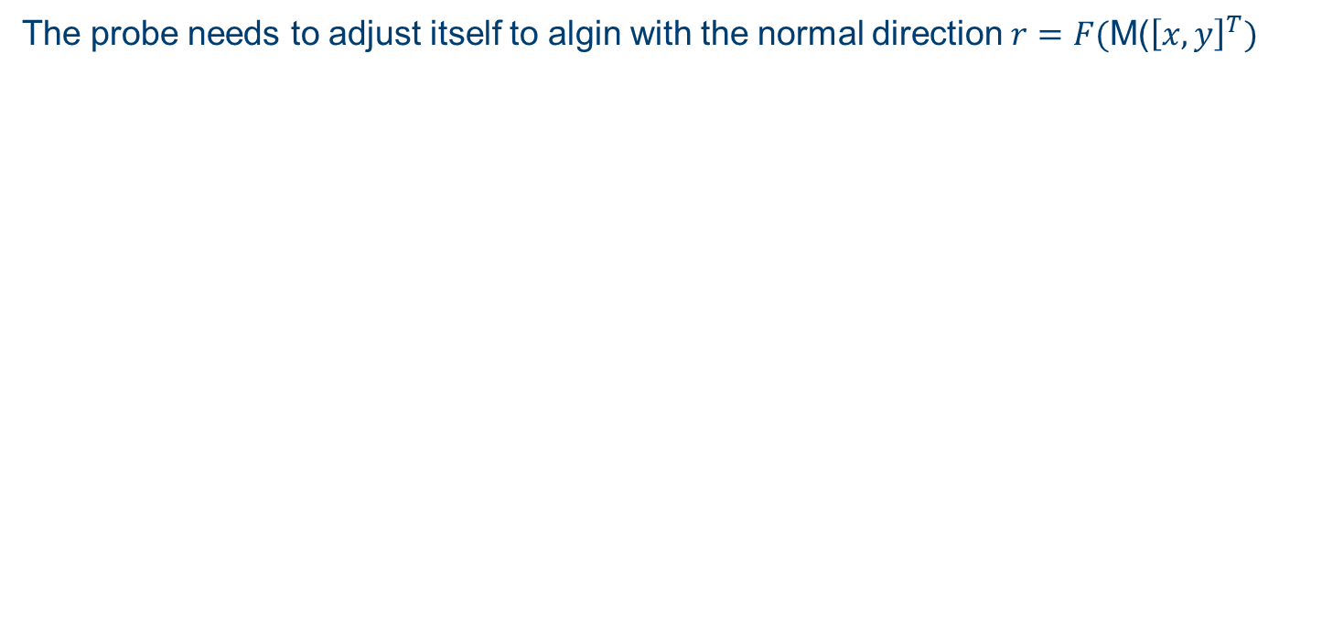
TCP positioning
The probe needs to adjust itself to algin with the normal direction $r=F(\text{M}\text{(}{\left[x, y\right]}^{T})$
Query the point cloud map for normal vector direction at current position
M(${\left[x, y\right]}^{T}$) = ${\left[x_{0},y_{0},z_{0}\right]}^{T}$
Find the three unit vectors of desired probe system
${e_{z}={\left[x_{z}, y_{z}, z_{z}\right]}^{T}= −\left[x_{0},y_{0},z_{0}\right]}^{T}$
Constraint $e_{y}$ to be in $YZ_{R}$ plane and $e_{y}⊥e_{Z}$
${e_{Y}={\left[x_{Y}, y_{Y}, z_{Y}\right]}^{T}= −\left[0,\frac{abs\left(k\right)}{\sqrt{1+k^{2}}},\frac{sign\left(k\right)}{\sqrt{1+k^{2}}}\right]}^{T}$, $k=−\frac{z_{z}}{z_{y}}$
Solve for $e_{X}⊥e_{Y}$ and $e_{X}⊥e_{Z}$
$e_{X}={\left[x_{X}, y_{X}, z_{X}\right]}^{T}=cross(e_{Y}, e_{Z})$
$R=\left[e_{X}, e_{Y}, e_{Z}\right] −−−−→r=[r_{x}, r_{Y}, r_{z}]$
For safety, cap the angle between $e_{z}$ and $Z_{R}$ within ${15}^{°}$
Rodrigues

Slide 8
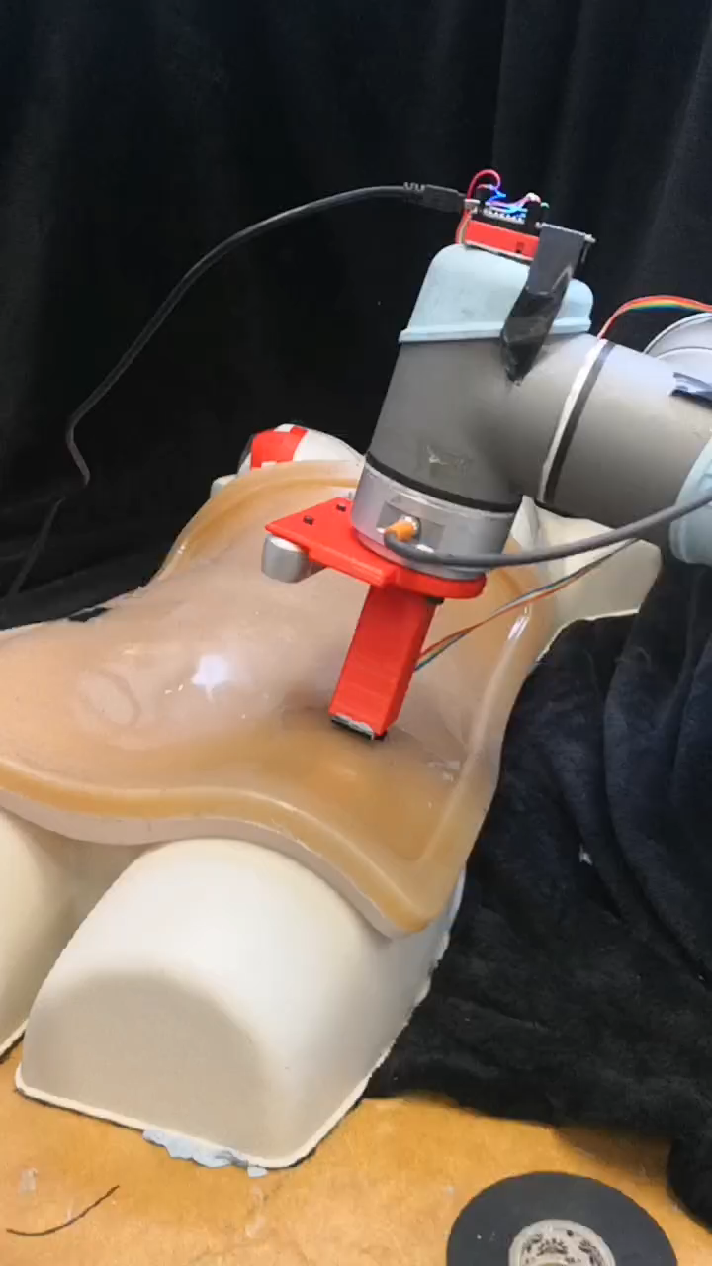
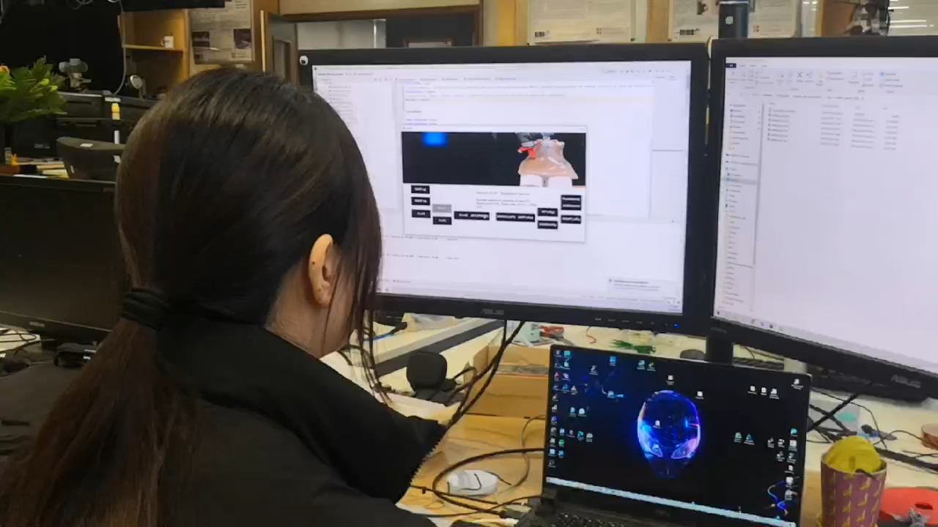
Experimental setup
Palpate three marked points quickly and accurately
Guess which point has a tumour beneath it
10 experiments per set
One set with full control, one set with shared control

Slide 9
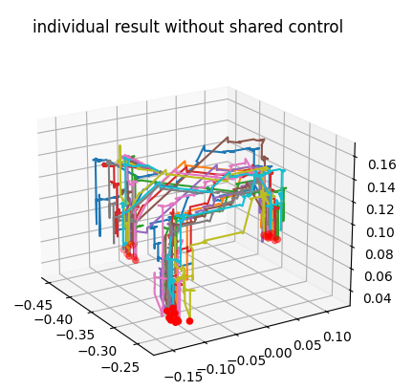
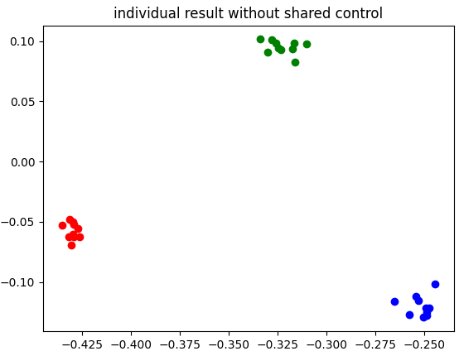
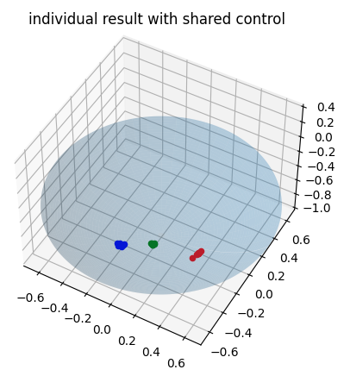
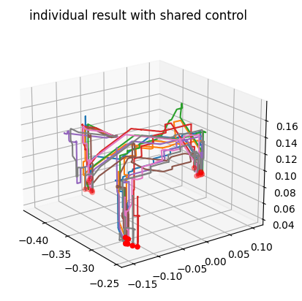
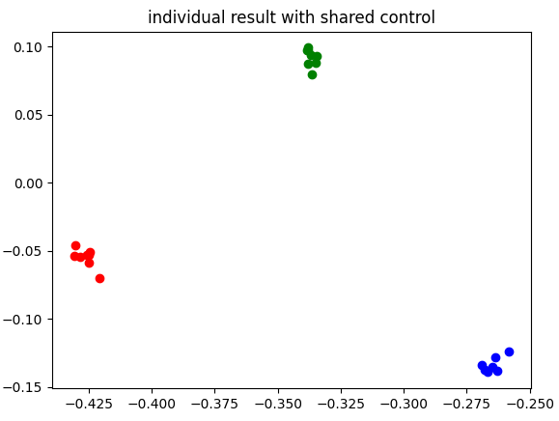
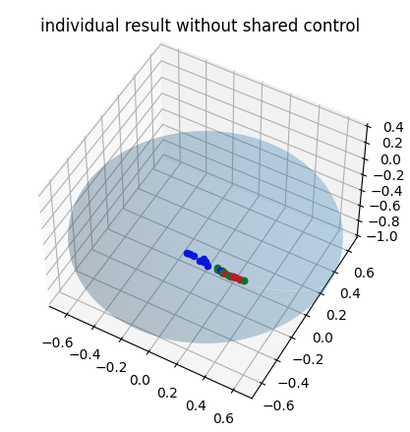
Individual result

Slide 10
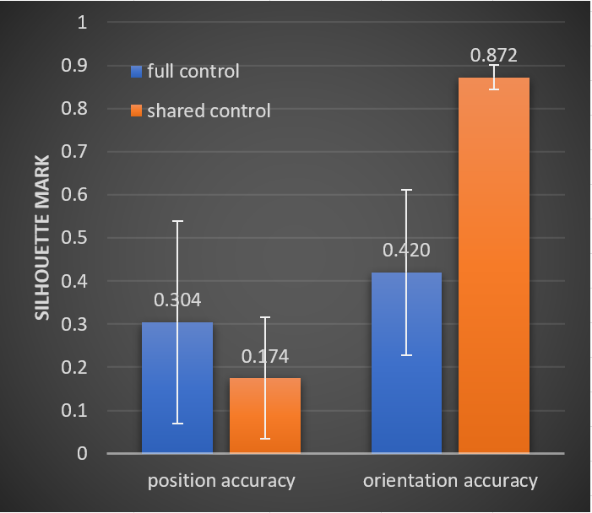
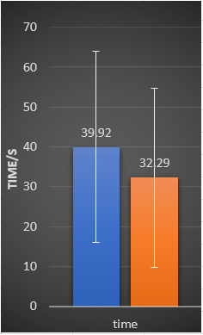
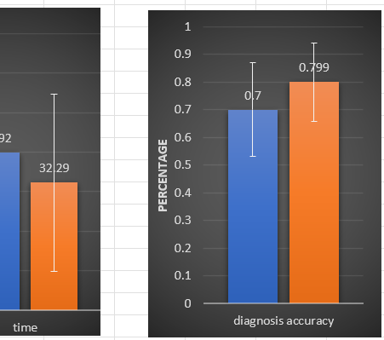
Overall result

Slide 11
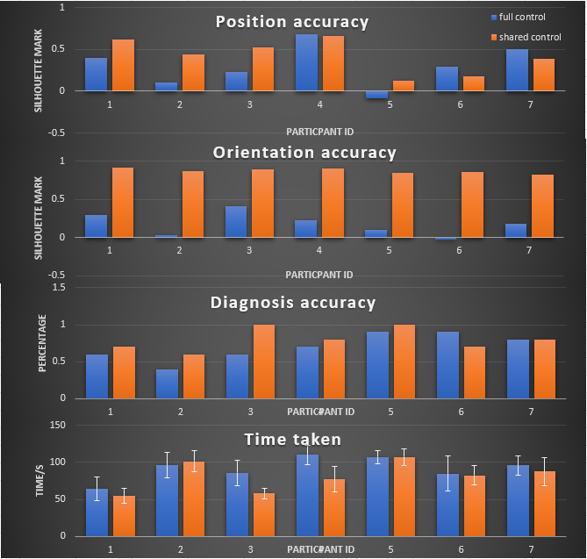
Participant ranking

Slide 12
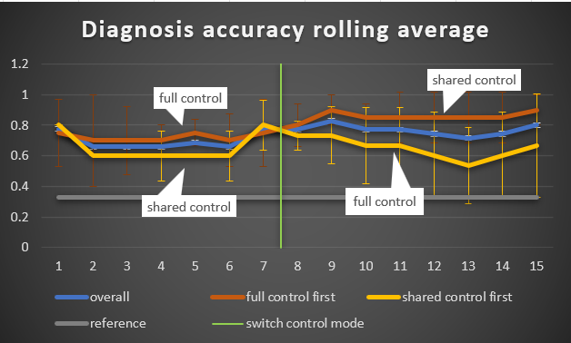
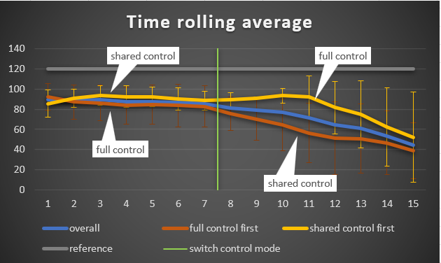
Learning curve

Slide 13
Next step?

